Slide 1
IS113 Web Application Development 1
Debriefing on Trial Lab Test (Set A) ~ LAU Yi Meng ~

Slide 2
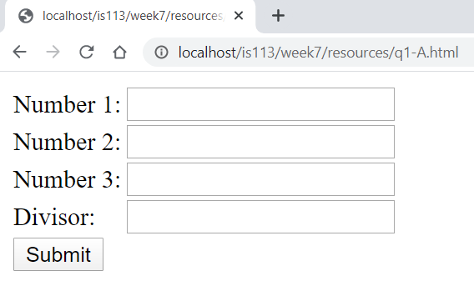
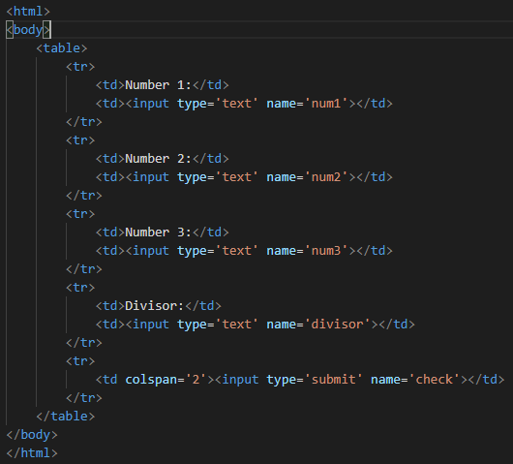
Question 1 – Part A
q1-A.html is provided.
Run it off your localhost to see the results.
Upon clicking the SUBMIT button, it submits to q1-A.php via HTTP POST.
Take note of the names.
It is a form processing question. Missing <form> tags
Method via POST.

Slide 3
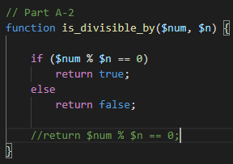
Question 1 – Part A
Create function – is_divisible_by ($num, $n) , returning a value as Boolean.
Printing out as an unordered list. Tags <ol>, <li>
Types of checks :
isset() to prevent user from going directly into q1-A.php
Number 1,2,3 must be numeric.
Divisor has to be numeric.
Question did not asked to output error messages
Do not need to handle in this case.
These are not specified in the question.
You can make your own assumptions.

Slide 4
Question 1 – Part A
Output:
Using 2 arrays : (1) to capture input from user, (2) to capture result – YES, NO
Using an associative array: E.g. $result = [ 2 => “YES”, 5 => “NO”, 6 => “YES” ] Try this out on your own.
Or any other ways …

Slide 5
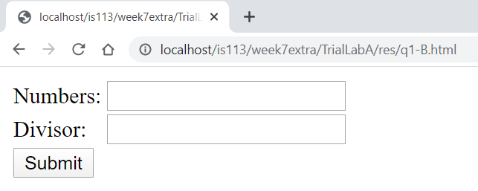
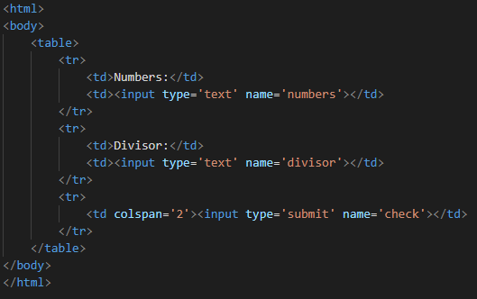
Question 1 – Part B
q1-B.html is provided.
Run it off your localhost to see the results.
One, or more numbers are input together in ONE form input field separated by comma.
Upon clicking the SUBMIT button, it submits to q1-A.php via HTTP GET.
Take note of the names
It is a form processing question. Missing <form> tags
Method via GET.

Slide 6

Question 1 – Part B
Create function – is_divisible_by ($num, $n) , returning a value as Boolean. Similar from Part A.
explode function with comma as the separator
Rest is similar to Part A.

Slide 7
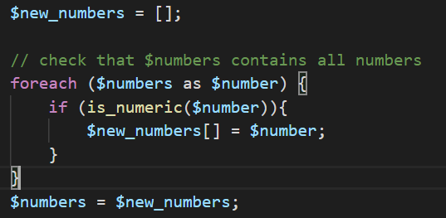
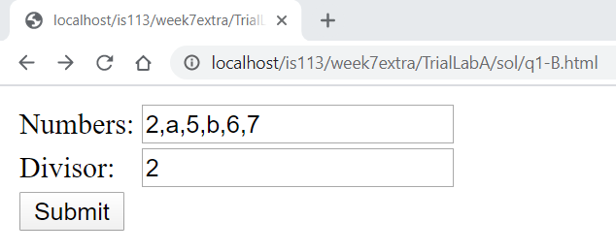
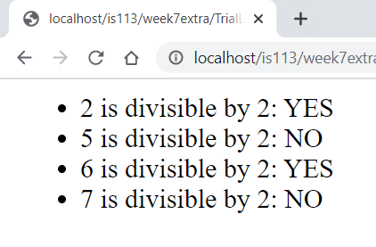
Question 1 – Part B
Additional handling [not part of the question]. Based on the list of numbers provided.

Slide 8
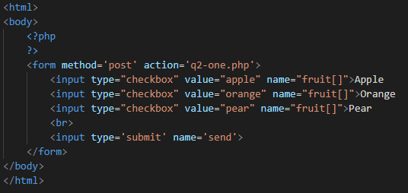
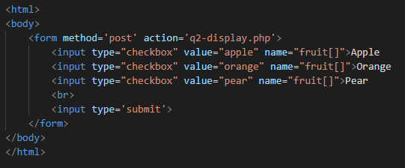
Question 2
All are php programs.
Look at what codes are provided.
Read the Sample Output to get an idea of how the programs work.
q2-one.php
q2.php

Slide 9
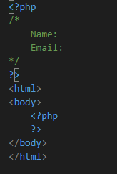
Question 2 – Part A
q2-display.php
Start with q2.php
User clicks on words, the corresponding checkboxes will be selected/unselected : <label>
In q2-display.php
get values (checkboxes) from q2.php via $_POST
display in table format.
display pictures <img>
Types of checks :
isset() to check if the checkbox is empty. If not prompt the message.

Slide 10
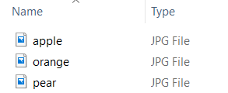
Question 2 – Part A
Processing of images files.
The values are the same. To dynamically print out the image, the “value” can be used.

Slide 11
Question 2 – Part B
q2-one.php
Start with q2-one.php
Self-submitting form, back to itself (q2-one.php)
Read through the sample examples.
Points to note:
Get values (checkboxes) via $_POST
Display in table format.
Display pictures <img>
Display a message “You selected X fruits”.
count function

Slide 12

Question 2 – Part B
Types of checks :
[Good practice, usually via $_GET], if the user goes directly to the page, with partial input variables. You will not want to process it if it is loading for the first time.
E.g submit via $_GET with checkbox with data only.
Checkbox can be not checked. This can be acceptable. E.g. in this question.
Check if the submit button is clicked via isset($_POST[‘send’])

Slide 13
Question 3
Working with associative array and arrays in array.
Suggested approach:
Identify the pattern in the data provided.
Sift out the required information, assigned it to a local variable for easy processing.

Slide 14
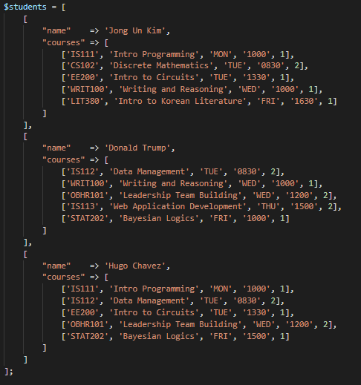

Question 3
Data for the dropdown list

Slide 15
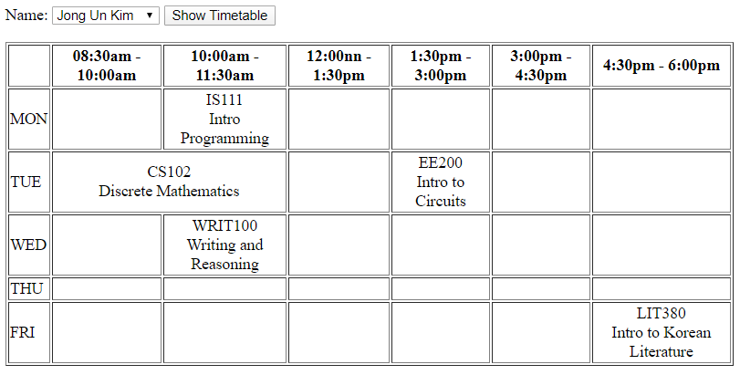
Question 3

